Slide 1
CAR WITH AUTOMATIC PARKING AND ACCIDENT DETECTION SYSTEM WITH WIRELESS CONTROL
EE330
Sanju kumar Rohit Kumar Subhash K. Mehta Shivraj Jagdish Prasad Aman Kumar

Slide 2
AGENDA
Introduction​
Required Hardware
Assembling the hardware
​Parking Algorithm
Videos and Images
Summary​

Slide 3
INTRODUCTION
As the number of cars increase on the road, it becomes increasingly difficult to find a parking space. However, the final option of parallel parking is usually a driver’s worst nightmare because not only of the driver’s own skills but also the possibility of other drivers bumping into their parked vehicle. As such, people will drive around for half an hour to avoid facing this challenge. In an attempt to provide more simplicity into people’s lives, our project will develop a system that enables a car to parallel-park itself and sends its location to owner if its parked and to emergency numbers in case of accidents.

Slide 4
HARDWARE USED IN THIS PROJECT
Hardware | Quantities
Servo motor | 1
Arduino | 1
Battery | 2
IR Sensor | 3
UltraSonic sensor | 1
Motor | 4
Breadboard | 1
Frame | 1
Buzzer | 1
and some connecting wires.

Slide 5
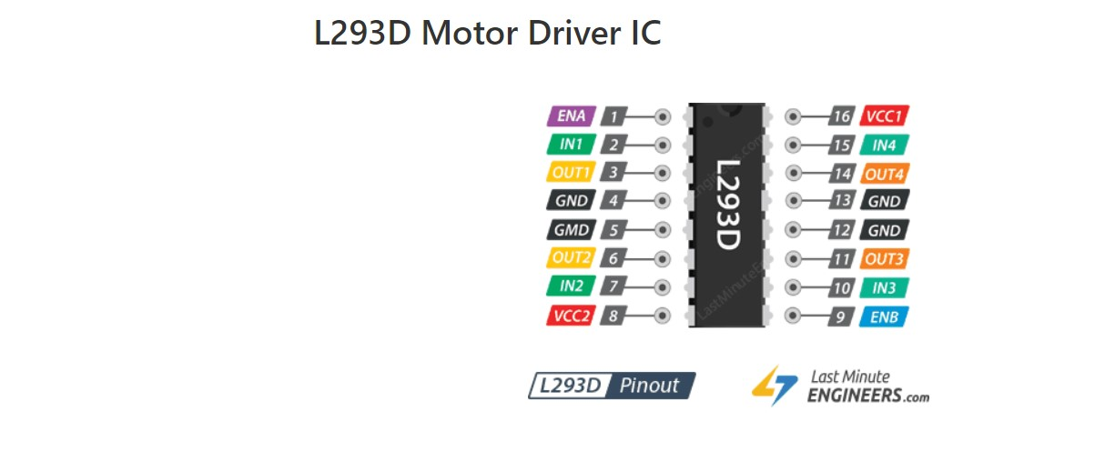
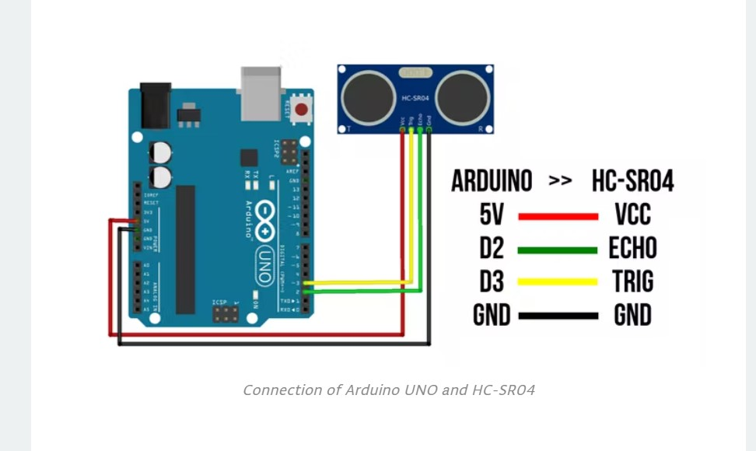
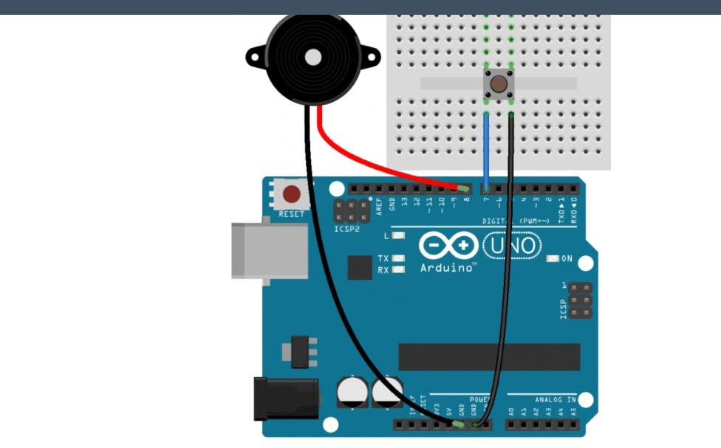
ASSEMBLING THE HARDWARE
Firstly we are going to make the body of car where we put our components.
We attaching all the components on the breadboard.
connecting the motors with the ic L293D.
L293D used for controlling the motors with desired speed direction.
From L293D we connected the arduino.
Arduino has the codes to control IC(L293D).
We also use an Ultrasonic sensor to measure the obstacle distance from our car and IR sensors to detect obstacles and desired parking slots.
We use the buzzer to give a beep sound when our car moves backward and when it is parked.
With the help of the GSM module(SIM800L),we send message to the owner that his car is parked and with the help of Gyro sensor we detect the accident.
We use same GSM module to give a message to hospital and his family members when there is accident happens with the car.

Slide 6
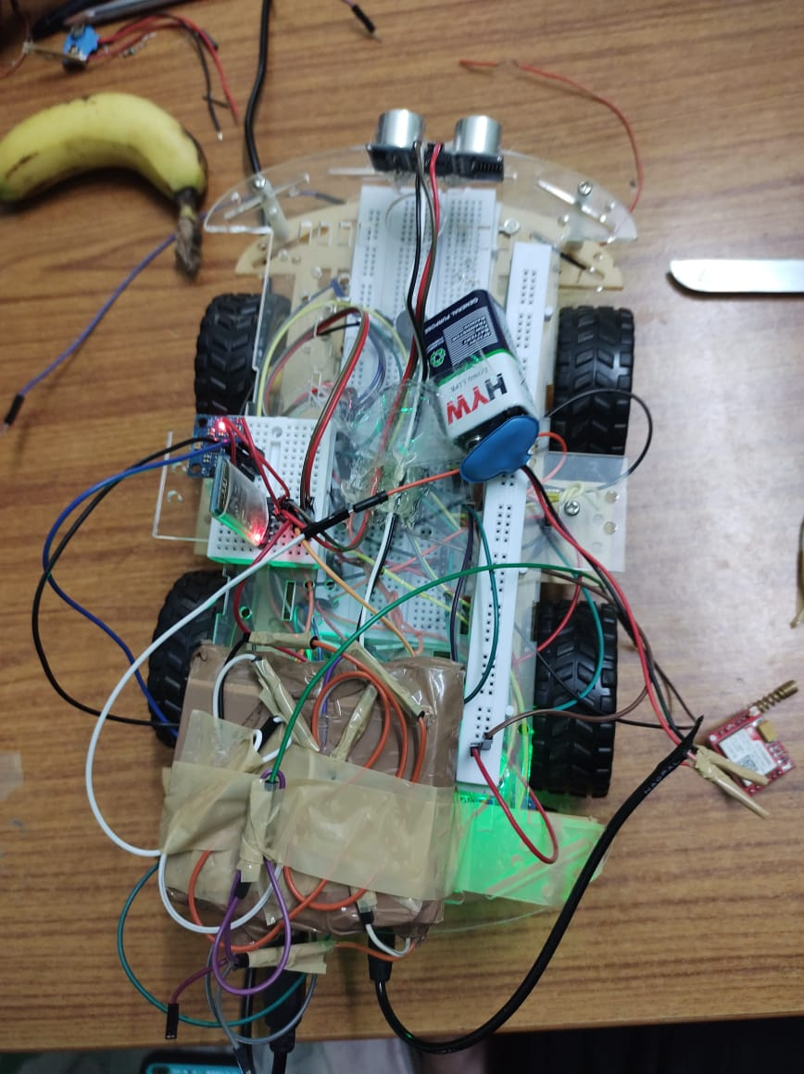
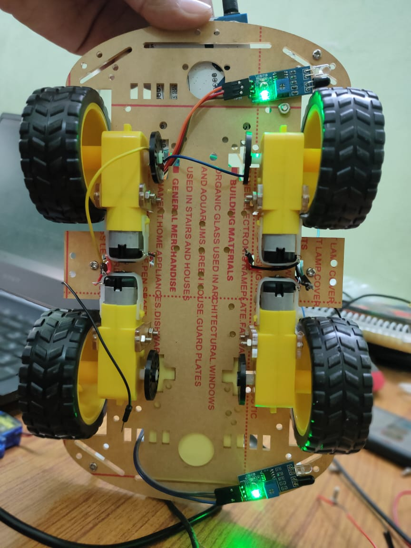








Slide 7
PARKING ALGORITHM
First, the car moves forward searching for parking space to the right of it using IR sensors.
If there is enough space to park the car, then it goes in parking mode. Otherwise, it goes on searching for it.
Next, it will move in the parking space by moving right and slightly forward.
Then it moves backward till there is no enough space.
It repeats previous two steps until there is not space to the right and back of the car. This ensures efficient parking.
At last it stops and a beep sound is produced indicating
that the car is parked.
.

Slide 8
Accident Detection
First, the car is moving safely.
In case of an accident, the distance from the front will be less
which is sensed by the ultrasonic sensor or the gyro sensor detects the flipping of the vehicle.
This moment, a function to send SMS and its location is called, which sends a message to the receiver.

Slide 9
Methodology
The following steps were involved in the project:
Write the INO code for to control motor and sensors of the car and store it in Arduino.
Perform software simulation to verify the correctness of the program.
Make all connections and complete the hardware implementation.
Used ultrasonic and infrared sensor for object detection and gyro sensor for accident detection.
Used GSM SIM800L for mobile communication.
If the ultrasonic sensor detects some obstacle ahead, it will check for which direction to turn and proceeds forward.
Infrared sensor at side detects the free slot to be park in.
Gyro sensor will be used to detect accidents, soon after that GSM module will send message with location to any of the family member.
Create an android application to provide a user interface for communication with the user.
Mobile app will show the current status of the parking slots to the user, if slot is free, the data of the IR sensor will be displayed on the app through ESP8266 BT module which uses MQTT.

Slide 10
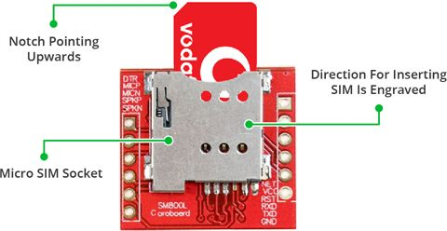
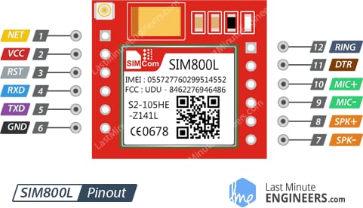
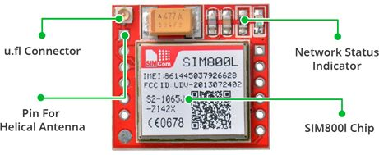

Slide 11
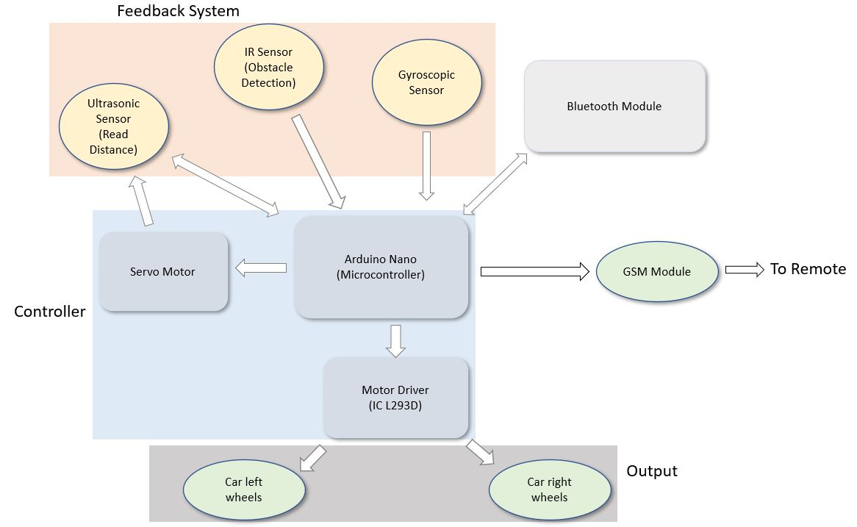
Flow Diagram

Slide 12
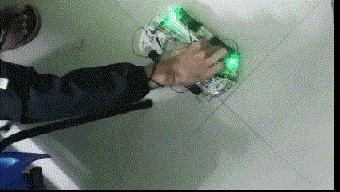

Slide 13
SUMMARY
A car with automatic parking and accident detection using
Arduino is an excellent example of automation. We know
parking is difficult for a new driver, Our parking algo-
rithm will help those persons, and our accident detection
algorithm helps to save someone’s precious life. During
this project, we came across many sensors and their
practical use.

